Slide 1
De‑identification of Structured EHR Using Machine Learning
Luyao Chen, Kai Zhang, Xiaoqian Jiang

Slide 2
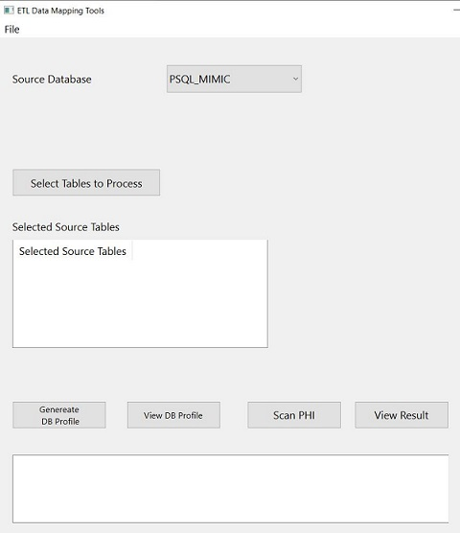
The PHI Data Scan Tool
Database
Read
Profile
Scan
Report
Text Files
Workflow explaination

Slide 3
Prerequisites
Windows 10 or Mac OS
with Python3.8 or Python3.9
with Github tools installed
Key python decencies
PYQT6 - Python GUI packages
Dataprofiler – Data statistics collection
Xgboost – Machine learning Library
Sqlalchemy – Python SQL toolkit and Object Relational Mapper for Database connection

Slide 4

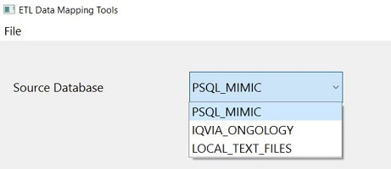
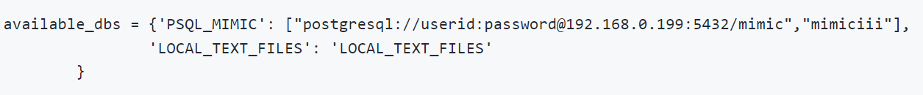
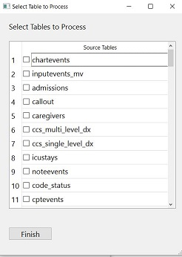
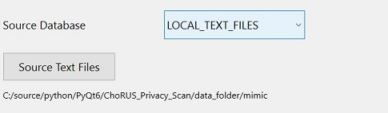
Step 1: Select Database/Table
Select source data
PostgreSQL database - will support more database type soon
Setup in config.py
Select Tables
Folder for CSV Files

Slide 5
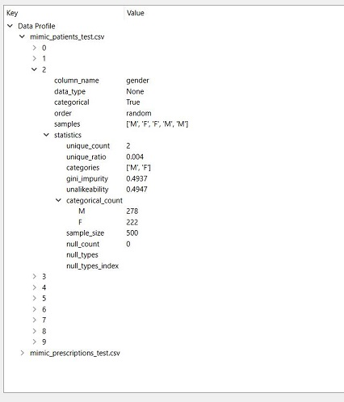

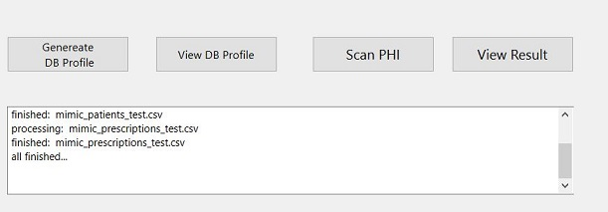
Step 2: Profiling
Select “Generate DB profile” and let the algorithm calculate statistics for each column
The statistics will be used to train the PHI detection algorithm
We will sample 1,000 records for statistics analysis. The setup can be changed in config.py.
Reports can be read on the pop out window

Slide 6

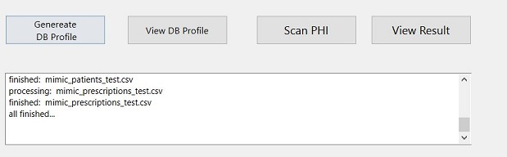
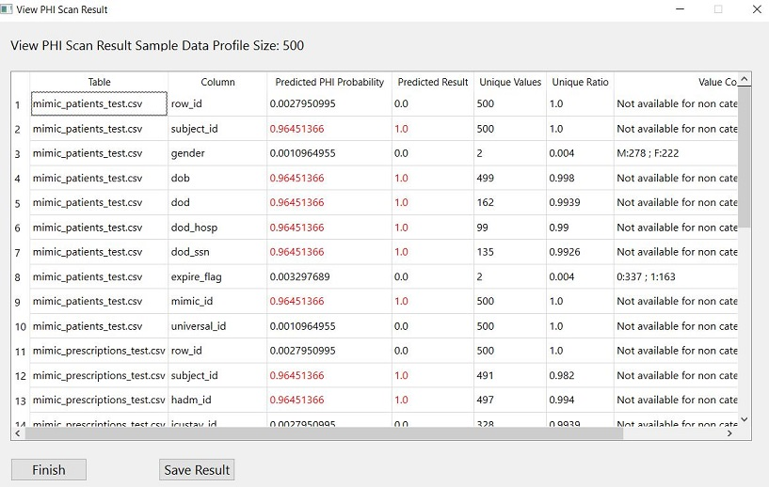
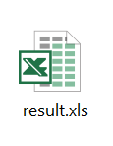
Step 3: Scanning and Reporting
Select “Scan PHI” to run the PHI detection algorithm
Results will show in a tabular format
Can be saved in excel sheet

Slide 7

Step 4: Fill in HIPPA Safe Harbor Checklist
Remove the identified PHI columns or cover the privacy information
Fill in the Checklist form
Share data

Slide 8
The De-identification Standard
A clean list of sensitive attributes based on the HIPPA safe harbor regulation
(A) Names
(B) All geographic subdivisions smaller than a state, including street address, city, county, precinct, ZIP code, and their equivalent geocodes
(C) All elements of dates (except year) for dates that are directly related to an individual, including birth date, admission date, discharge date, death date, and all ages over 89 and all elements of dates (including year) indicative of such age
(D) Telephone numbers
(L) Vehicle identifiers and serial numbers, including license plate numbers
(E) Fax numbers

Slide 9
The De-identification Standard
(M) Device identifiers and serial numbers
(F) Email addresses
(N) Web Universal Resource Locators (URLs)
(G) Social security numbers
(O) Internet Protocol (IP) addresses
(H) Medical record numbers
(P) Biometric identifiers, including finger and voice prints
(I) Health plan beneficiary numbers
(Q) Full-face photographs and any comparable images
(J) Account numbers
(R) Any other unique identifying number, characteristic, or code, except as permitted by paragraph (c) of this section [Paragraph (c) is presented below in the section “Re-identification”]; and
(K) Certificate/license numbers

Slide 10
Detecting Sensitive Information with Feature Engineering
Using engineered features, ML can be trained to learn if a column is PHI or not.
The features we used are:
1. Data type (categorical, datetime, integer, float, string)
Categorical data type fields are likely to be PHI: e.g. gender (M/F or 0/1), race (White/Black/Asian/etc. or 0/1/2/3)
Datetime data types are very likely to be PHI: e.g. birthdate, check-in/out date, death date, …
String data types can sometimes be PHI: e.g. gender, race, address,…
Numerical data types is unlikely to be PHI: e.g. vital sign test, lab test results, etc.

Slide 11
Detecting Sensitive Information with Feature Engineering
2. Uniqueness count, unique ratio (%): how many unique value
If the items in of field is unique among all patients, it is very likely to be PHI, e.g. SSN number, MRN number, Encounter number, …
3. Statistics: min, max, mode, median, sum, variance, std, skewness, kurtosis, quantiles, median_abs_deviation
If a column is numerical data type, their statistics also tells information about whether they are PHI
For example, if their min values is a very large number, say 1242642567, then it is very likely to be a PHI, e.g. SSN/MRN
On the other hand, non-PHI lab tests/vital signs usually do not have such numbers of such scale

Slide 12
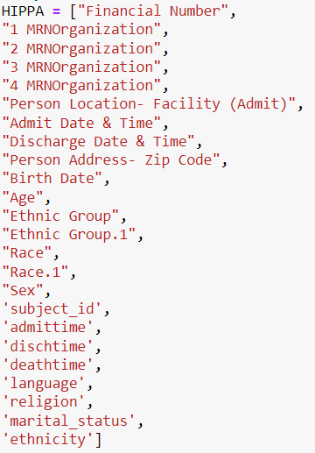
Experiment
ML model is trained on local structured EHR data:
The data contains 5,000 patients (rows)
Near 1,000 columns with 67 columns being PHI
The model engineered 72 statistical values from each column to be the features to train the algorithm

Slide 13
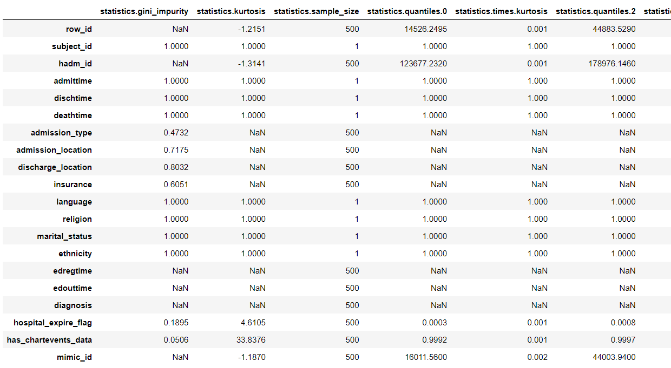
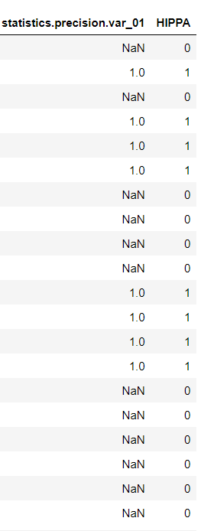
Example of the Training Data
Prediction Target
Fields in the EHR

Slide 14
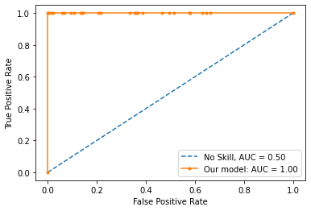
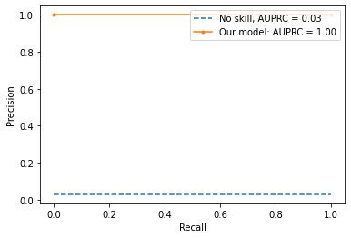
Result
AUC: 1.000 AUPRC: 1.000
==> Sensitivity (Recall, TPR): 0.000
==> Specificity: 1.000
==> Negative Predictive Value (NPV): 0.971
==> Accuracy: 0.971

